Slide 1
WQD7005 Data Mining Project
KLCI Stock Market Prediction

Slide 2
Introduction
Problem Statement: Investors are faced with problem of trading as they do not know which stocks to buy or sell to achieve optimum profit. Predicting stock price on day-to-day basis is harder due to price fluctuation influenced by daily news.
Objective: To increase prediction accuracy of the stock direction on daily basis so that investor able to make correct decision.

Slide 3
Method
Use Machine Learning Algorithms to predict Stock Price Direction for the next day.
Machine Learning Algorithms are deployed for stocks from different industry.
Prediction accuracies are evaluated for the Machine Learning algorithms to identify best algorithm for different stocks from different industry.
Machine Learning Algorithms deployed – Regression, Decision Tree, Support Vector Machine and Random Forest.
Focus on Four Industries – Steel Products, Banking, Energy, Technology.
Industrial Products – Lionind, Ssteel, Annjoo and Masteel
Banking – CIMB
Technology – Dufu
Energy – Sapura Kencana

Slide 4
Data Flow Plan
Crawl News Data for the Past One Year in I3.Investor
Sentiment Score and Technical Indicators are as input variables while the price up/down for the next day are used as target variable.
To employ Different Machine Algorithm and Check Accuracy
Download the Historical Price of Stocks from Investing.com – Open Price, Close Price, Day Low, Day High and Percentage of Price Change
Crunch the News Sentiment Score(Positive and Negative Polarity)
Calculate the Technical Indicators based on the Historical Price

Slide 5
Collecting/Preprocessing Data

Slide 6
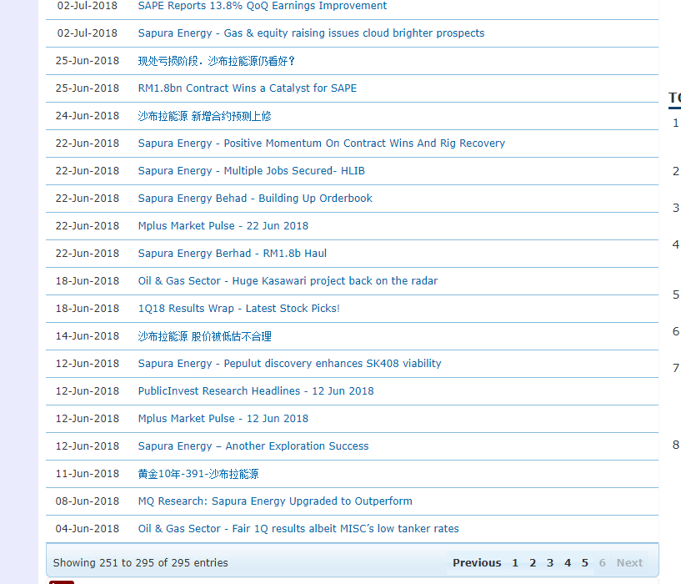
Historical News from I3

Slide 7
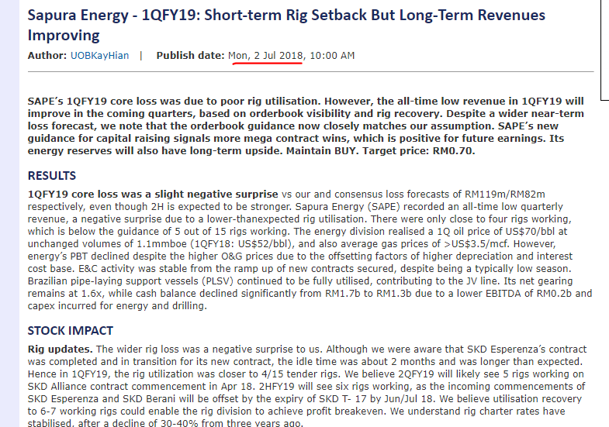
Content from the News

Slide 8
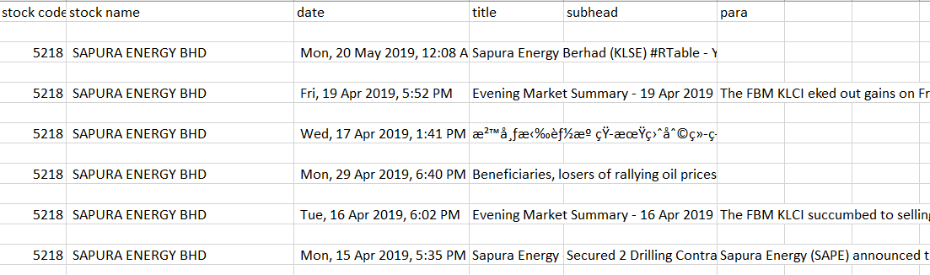
Crawled Time-Stamped Financial News

Slide 9
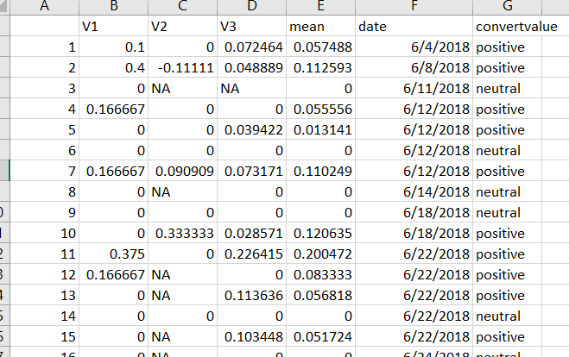
Sentiment Analysis on Timestamp Financial News

Slide 10
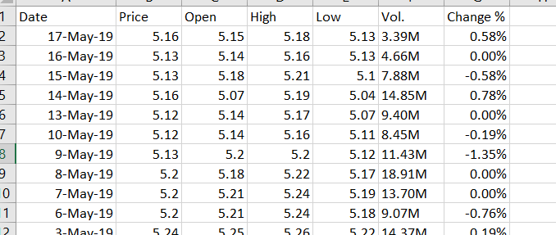
Downloaded Stock Data from Investing.com

Slide 11
Technical Indicators
Relative Strength Index – Momentum Indicator that measures the Magnitude of Recent Price Changes to evaluate overbought or oversold conditions in the price of stock or other asset.
Exponential Moving Average – A type of Moving Average(MA) that places a greater weight and significance on the most recent data points.
Moving Average Convergence Divergence(MACD) – MACD is calculated by subtracting 26-period Exponential Moving Average(EMA) from the 12-period EMA.
Commodity Channel Index(CCI) – Momentum-based oscillator used to help determine when an investment vehicle is reaching condition of being overbought or oversold.
Chande Momentum Indicator(CMO) – Used to gauge price momentum just like the Relative Strength Index(RSI).
Williams’ Percent Change(WPR) – A Dynamic Indicator which determines whether the market is overbought/oversold.
Average Strength Index(ADX) – ADX Indicator is used to find whether Stock is in trend and also finds the strength of the trend.
Rate of Change(ROC) – The ROC indicator is a momentum-based technical indicator that measures the percentage change in price between the current price and the price a certain number of periods ago. It can be used to spot overbought and oversold conditions.

Slide 12
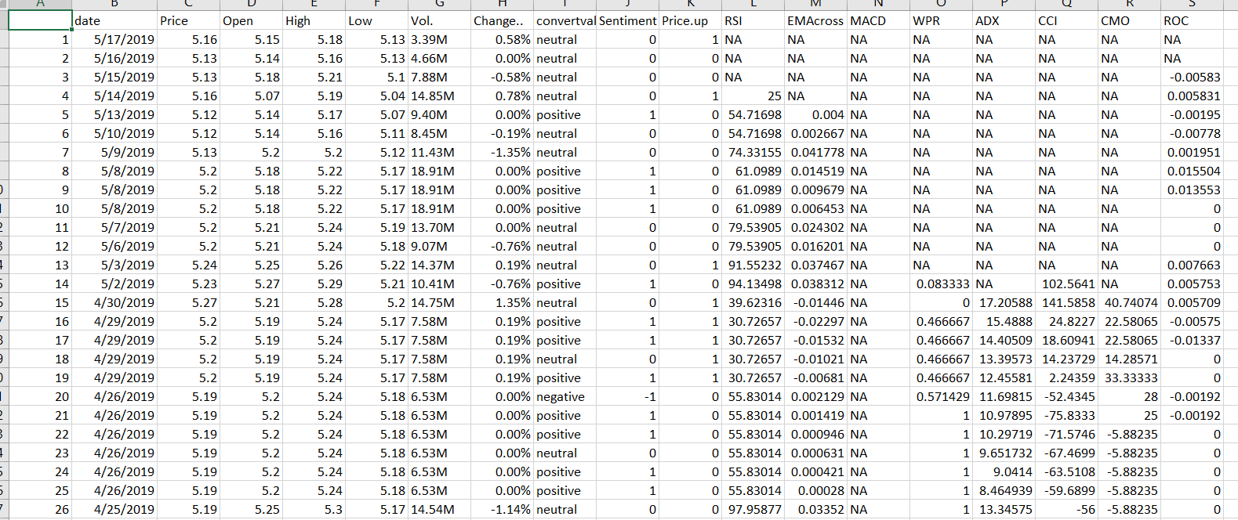
Calculated Technical Indicators Merged with Sentiment Polarity

Slide 13
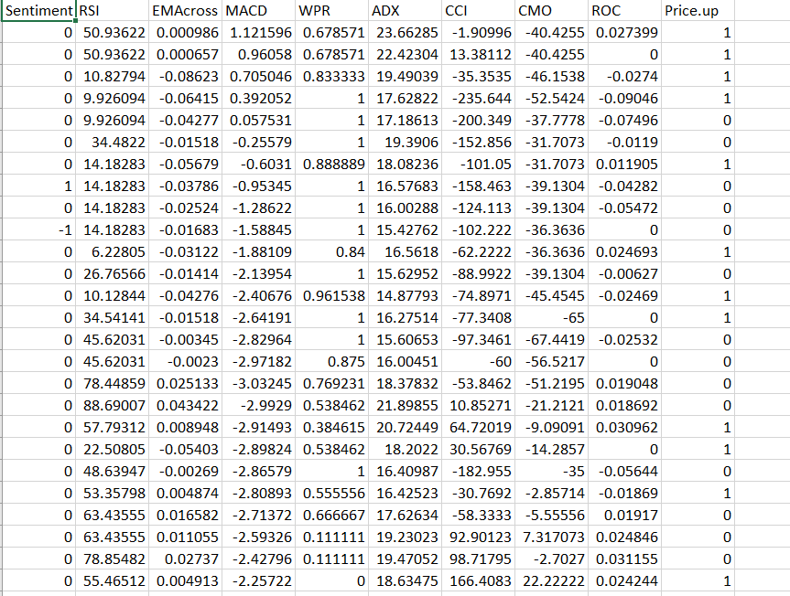
Pre-processed Data Before Loading into SAS

Slide 14
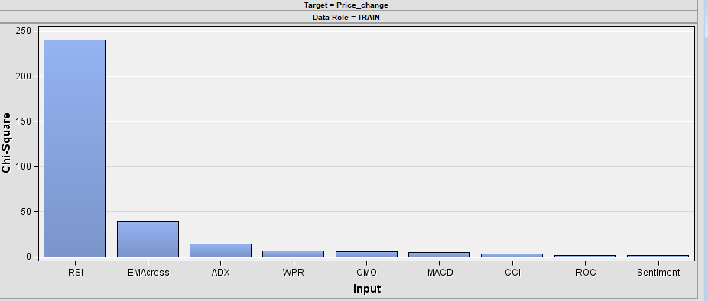
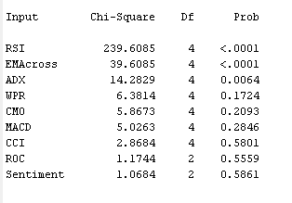
Descriptive Statistics – Chi Square

Slide 15
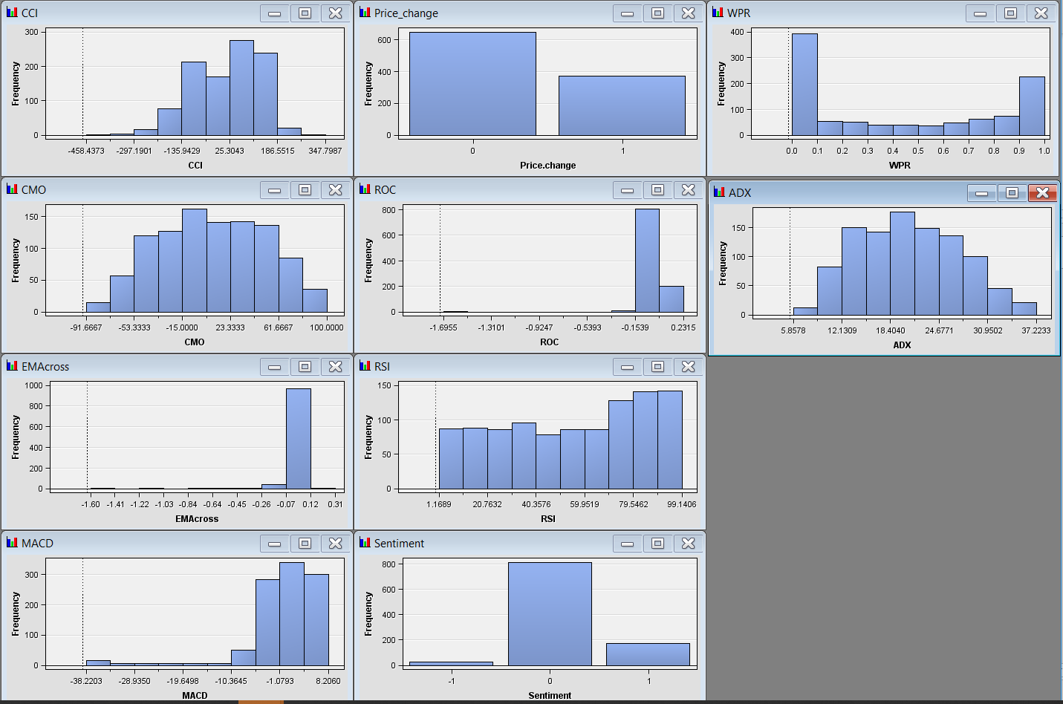
Checking Skewness of Independent Variables

Slide 16
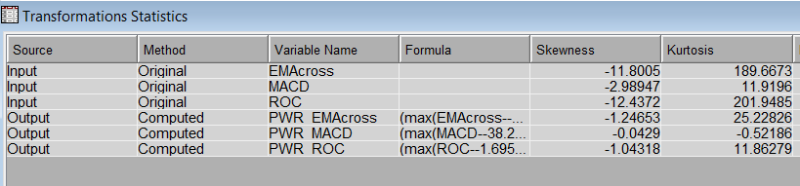
Data Transformation

Slide 17
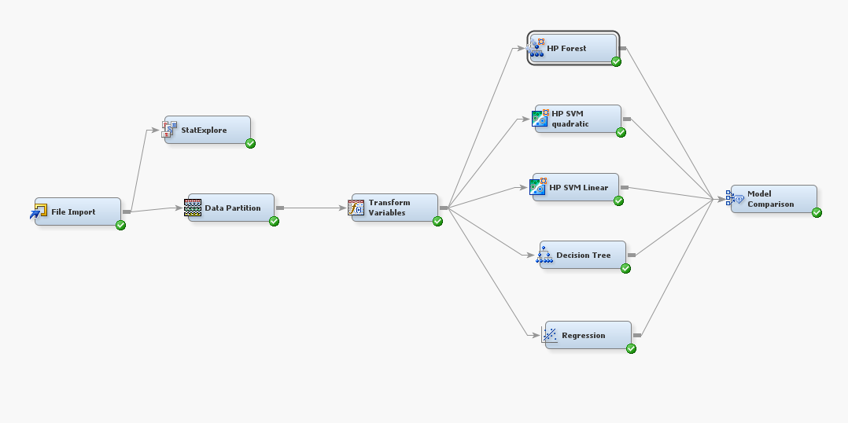
Predictive Modeling

Slide 18
Results

Slide 19
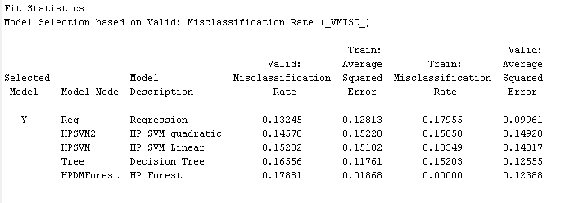
Steel Industry Model Comparison

Slide 20
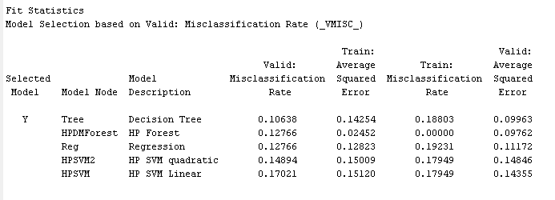
Banking Industry Model Comparison

Slide 21
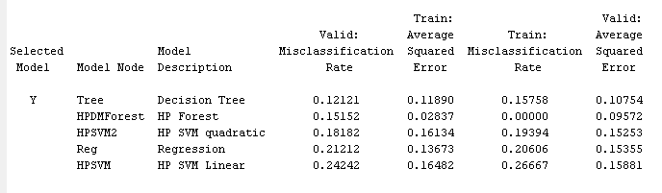
Technology Industry Model Comparison

Slide 22
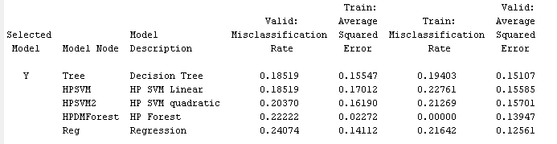
Energy Industry Model Comparison

Slide 23
Summary and Conclusion
A particular Machine Learning Algorithm may be better suited to a particular stock, say Energy Stock, whereas the same algorithm may give lower accuracies while predicting other type of stock, say Technology Stock.

Slide 24
Recommendation for Future Studies
More stocks shall be used as sample to test the machine learning algorithm.
In this project, the machine learning algorithm only able to predict stock price for the next day. In future, a hybrid machine learning model involving both Fundamental and Technical Analysis can be used to predict stock price. It could be more effective to use the hybrid machine learning model.

